Slide 1
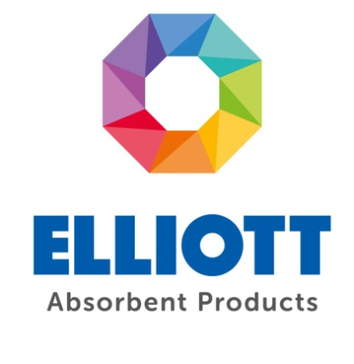
PRESENTATION

Slide 2
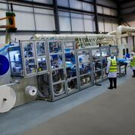
WHO ARE ELLIOTTS?
Established in 1982
Located in Littleborough, Lancashire – Close to the M26
UK’s Largest manufacturer of food absorbents
BRC ACCREDITED – Grade AA

Slide 3
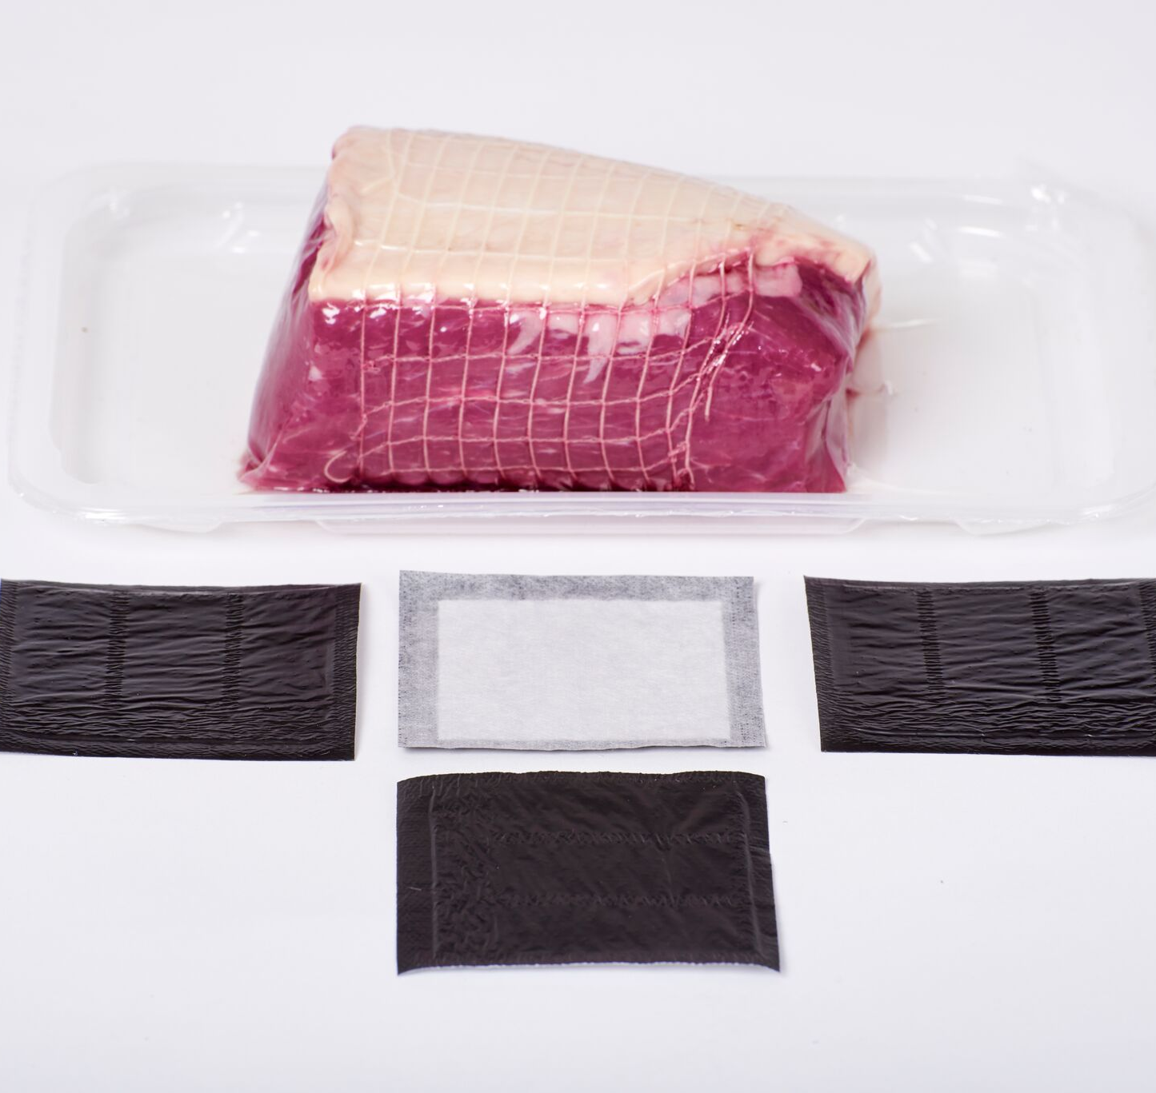
WHAT IS UNIDRY?
Super absorbent – sealed edge meat pad
10-26 Litres per square metre absorbency
Tremendous blood absorption under load
10 years research and development
Replace traditional cellulose and super absorbers

Slide 4
UNIDRY CONSTRUCTION

Slide 5

KEY FEATURES AND BENEFITS
UniDry has the lowest Carbon Footprint of any high absorbency pad on the market

Slide 6
VASTLY IMPROVED ABSORBENCY
MEAT PRODUCT | IN HOUSE PAD | UNIDRY | % IMPROVEMENT
VENISON - 300g | 16g blood absorbed (average) | 30.1g blood absorbed (average) | 88%+
Venison steak - 135g | 7g (avg) | 26.5g (avg) | 278%+
Beef lean joint - 600g | 23g | 33.3g | 45%+
Bavette steak - 287 g | 14.5g | 23.8g | 64%+
Large topside - 1.3kg | 18g | 34.3g | 90.5%+
Beef stir fry - 250g | 7.5g | 13.4g | 80%+
ASSURED TEST RESULTS (FEB 2020)

Slide 7
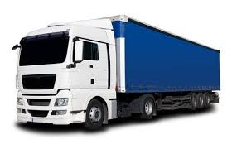
ULTRA THIN CONSTRUCTON
66% less transport miles compared to traditional airlaid

Slide 8

VASTLY REDUCED STORAGE REQUIRED
UniDry requires 66% less storage space than traditional airlaid pads

Slide 9

MUCH LESS OF NATURES CONSUMABLES
50% less cellulose & plastic required with UniDry cf. traditional pads.

Slide 10

ZERO DUST
Zero dust with UniDry - means no contamination and secondary cleaning required

Slide 11

UNIDRY
LETS DO MORE WITH LESS!!

